Slide 1
The effects of Early reflections on proximity, localization and loudness
David Griesinger

Slide 2
Early Reflections are Important
They give a vital sense of blend or ensemble to a group of musicians.
Lateral reflections contribute a sense space around the performers.
How can we know when we have enough?
How can we know if we have too many?
We find that current acoustic measures do not adequately answer those questions.
We need ACCURATE laboratory tests of concert hall conditions.

Slide 3
A/B comparisons
Sonic perceptions are strongly influenced by vision, memory, and expectation.
Research into sonic perception requires rapid A/B comparison of different stimuli through a system that accurately duplicates a real sound field.
Almost all research into musical acoustics lacks this basic requirement.

Slide 4
The result has not been pretty
To quote Lokki et al:
He finds the only perceptual attribute that correlates with preference for all listeners is unnamed, and currently un-measurable. He calls it “Proximity”
I have been calling it “Engagement”, “clarity”, or “Presence”.
“An interesting fact is that neither Definition and Reverberance nor EDT (early decay time) and C80 explain the preference at all. In contrast, the preference is best explained with subjective Proximity and with Bassiness, Envelopment, and Loudness to some extent. Further there is no objective measure that correlates to Proximity and overall average of preference.”

Slide 5
Why did we not discover “Proximity” sooner?
Proximity describes the perception that a sound source is sonically close to the listener.
You must study it without a visual image!
To study proximity in a laboratory your reproduction system must be able to reproduce it!
Almost all current systems cannot.

Slide 6
Most reproduction systems fail to reproduce the phase coherence of speech and music
The syllable “two” filtered by a 2kHz and a 4kHz critical band filter.
The prominent spikes create the perception of proximity.

Slide 7
The peaks are lost when phase is randomized by early reflections
The syllable “two” at 2kHz and 4kHz octave bands after filtering by a 40ms allpass filter

Slide 8
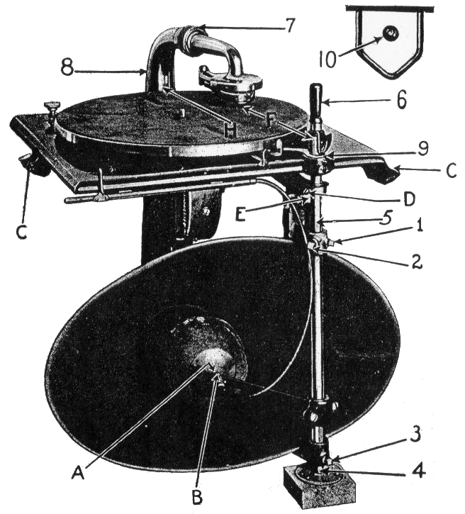
To reproduce “Proximity” the rule is simple: you need one linear phase speaker for each voice.
Edison, through meticulous A/B tests, succeeded with his “diamond disk” phonograph.
I heard one of these phonographs, and found it completely convincing.

Slide 9
Any reproduction system that uses multiple speakers for a single source will fail to accurately reproduce Proximity.
This includes Ambisonics, Wave Field Synthesis, and many others.
(The spatial aliasing of WFS is in the range where proximity is most audible.)
The exception is the current system by Tapio Lokki. He uses 9 speakers for the front image.
Each sound source is directed to the closest speaker without panning.
The reverberant field is reproduced similarly through 16 speakers.

Slide 10
Lokki’s playback system
Note the front speaker spacing is 22.5 degrees.

Slide 11
Tapio’s recording system uses a single speaker facing forward for each instrument.
Along with a smaller speaker facing up for the hall sound.

Slide 12
But does it really work?
Lokki’s system is the first I have heard that reproduces a believable front image of an orchestra as heard in a good seat.
But there is no way to A/B compare his system to the original. Is the reproduction really correct? How can we know?
Hall research desperately needs a Gold Standard with which laboratory systems can be compared.

Slide 13
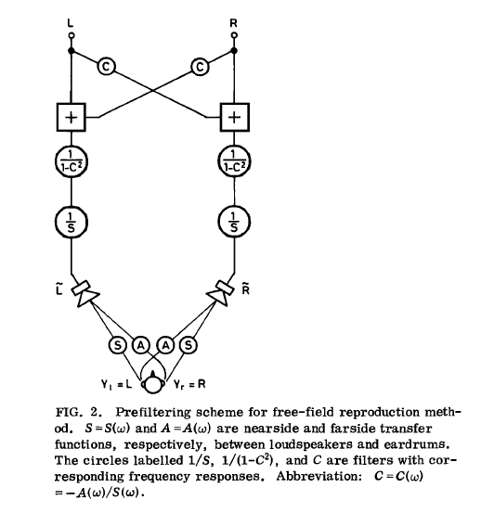
There is such a standard, and it is not new: Binaural recording and playback.
If the eardrum pressure of a listener can be recorded and reproduced, the sonic impression can be reproduced exactly.
This is not easy, but it can be done.
Schroeder’s playback system used crosstalk cancellation.
It requires a head clamp!

Slide 14
Schroeder’s source material did not possess proximity!
Schroeder played whole orchestra through two loudspeakers.
Proximity was already lost.
To reproduce Proximity you need one loudspeaker per source!
(As found by Edison, DG, Dick Campbell, Kimio Hamasaki and Tapio Lokki)

Slide 15
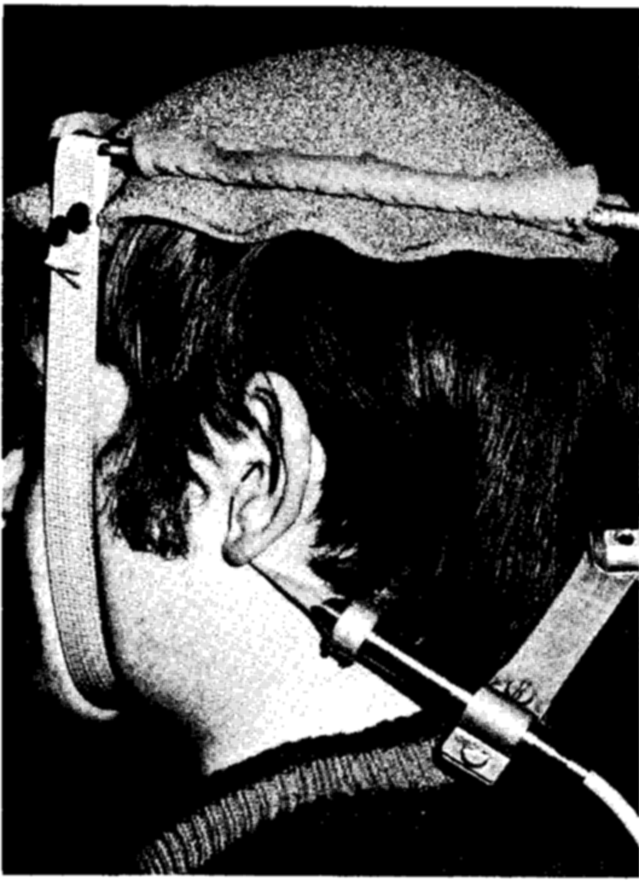
We need to combine Lokki’s electronic orchestra with a practical binaural recording and playback technique.

Slide 16
The major problem with binaural reproduction is not the lack of head tracking but the variability of headphone response between individuals.
Humans do not need head tracking to externalize sound!
Frontal, out of head localization, as well as realistic timbre depends on an accurate frequency response at frequencies between 1000Hz and 6000Hz.
If head-tracking is needed for believable localization, the equalization is not accurate enough for acoustic research!!!
But with individual headphone equalization almost all individuals can hear a credible reproduction of a scene or a concert.

Slide 17
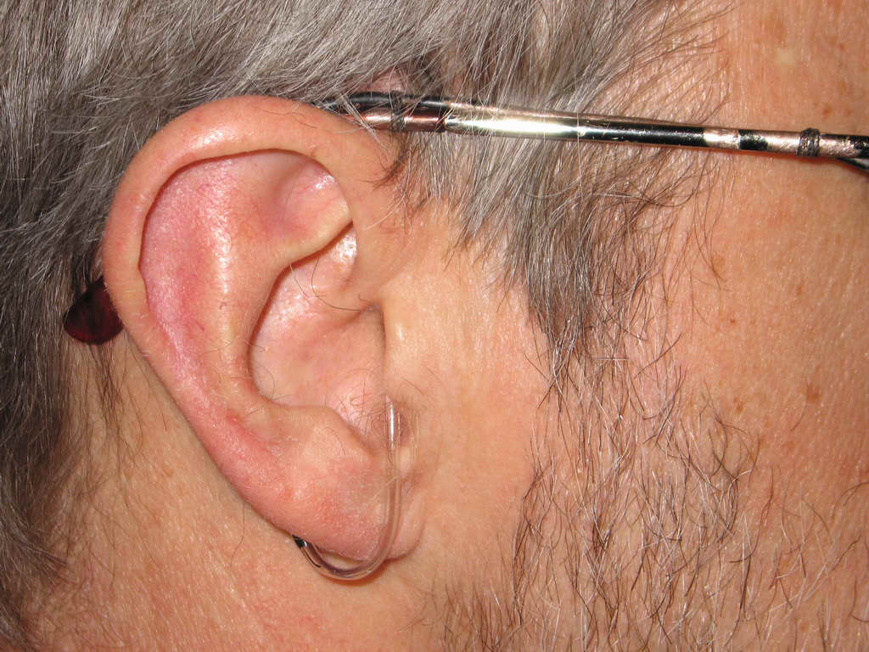
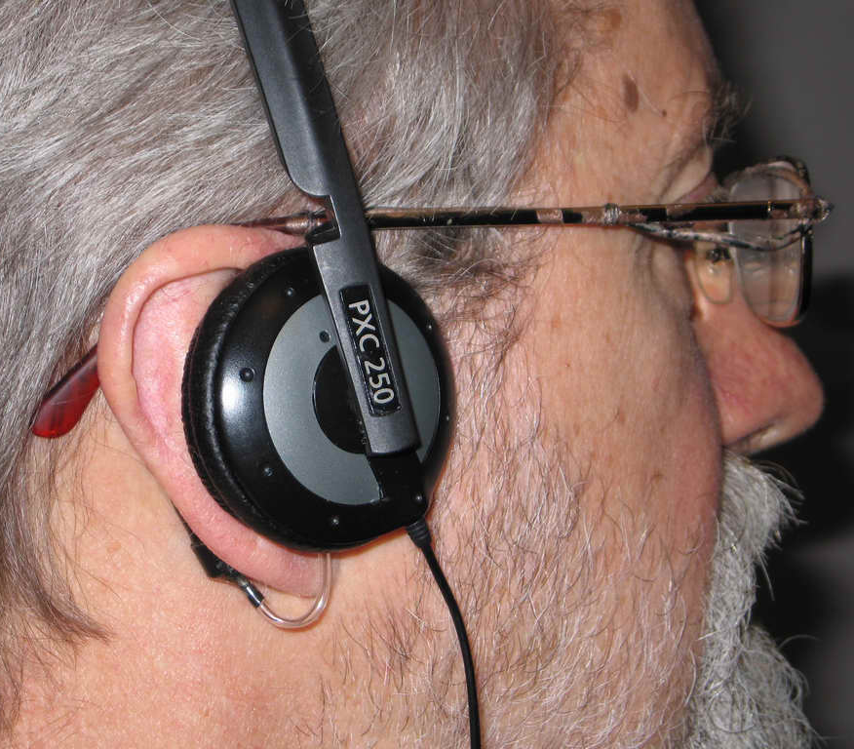
The best way to record and play back a scene is to use your own eardrums as microphones, and use them again to equalize the headphones. But this is not the only way!
The author’s probes from Modern soft-tip probe on eardrum Probe on eardrum for 1976 to the current day for recording headphone equalization

Slide 18
We record using Lokki’s electronic ensembles.
This photo shows a string quartet and soprano with two dodecahedral speakers.

Slide 19
And record with my dummy head and a soundfield microphone.

Slide 20
But you can learn a lot from existing data!
Part 2: Auralizing the effects of early reflections using existing binaural measurements.

Slide 21
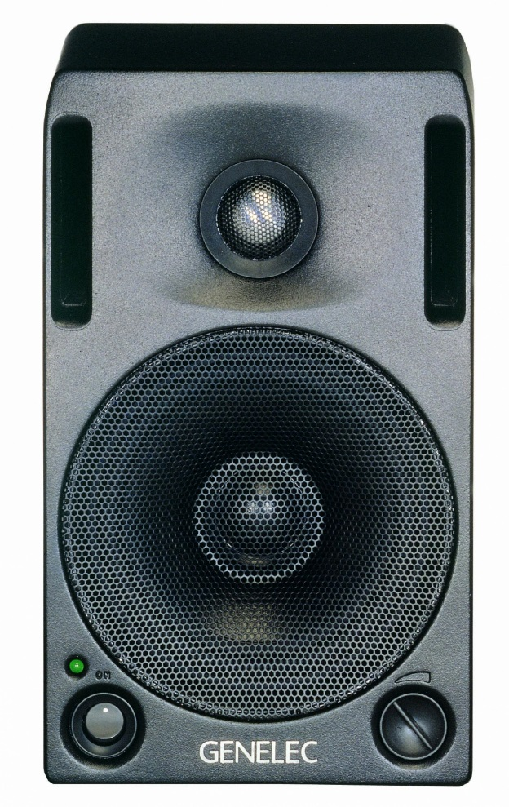
Existing binaural measurements in Boston Symphony Hall from April 2008
Source: Genelec 1029 left of the podium Receivers: Soundfield and David’s avatar

Slide 22
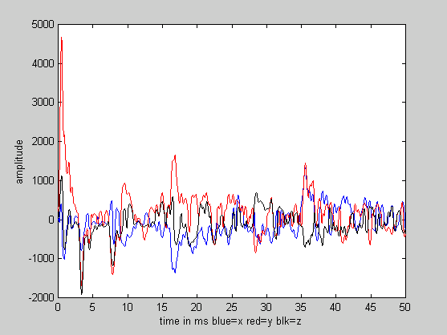
We had about 40 minutes to measure impulse responses to about eight seats.
Here is a 2kHz Soundfield plot from seat DD 11
Note the strong side-wall reflections at 17ms and 37ms.
These are clearly doubles – first and second order from the wall and the under-balcony ceiling.

Slide 23
Equalization of the source, dummy and headphones is vital!
We equalized the system from source to listeners ear by assuming the reverberation has a flat power spectrum after about 160ms.
My poster and preprints show the methods involved.

Slide 24
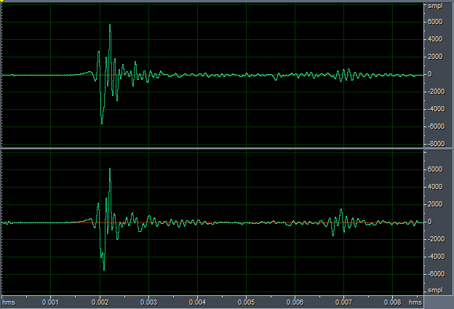
The direct sound at seat DD 11 shows the head was not perfectly aligned.
We adjust the ITD and ILD to center the direct sound
Direct Sound as measured Direct Sound after balancing

Slide 25
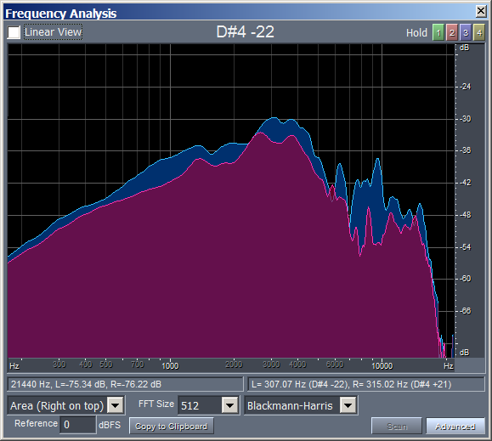
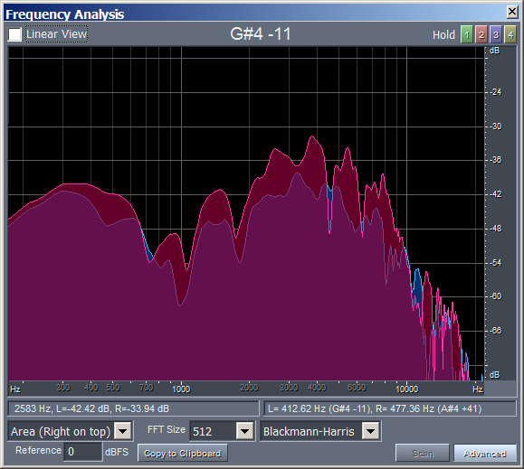
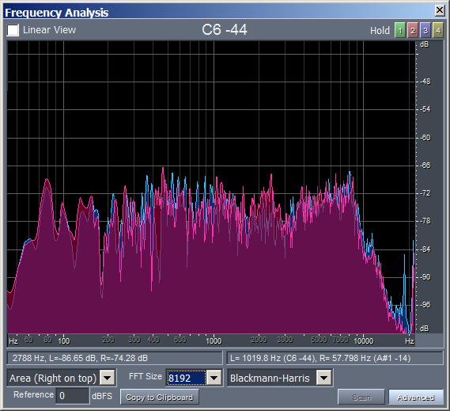
Spectra as measured at seat DD 11 after equalizing the reverberation
direct sound before balancing first lateral reflection 160ms reverberation
Blue is the left channel, red is the right channel. 6dB per grid

Slide 26
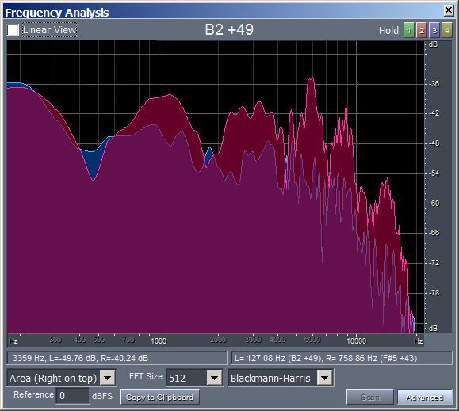
Binaural impulse response at seat R 11 after equalization and balancing shows a double reflection.
Binaural Impulse Response Spectrum of the first reflection at 20ms.
Note the dip at ~475Hz and peak at ~1000Hz

Slide 27
We can create an ensemble from a single binaural measurement, such as R 11 or D 11
We can create different apparent positions on stage by modifying the direct sound.
We can even compensate for directivity by adjusting the direct or reverberant level appropriately.
Since the anechoic tracks for each instrument are un-correlated, we can use the same reflection and reverberation data for each instrument.
These will be very similar for each instrument if the ensemble is small.

Slide 28
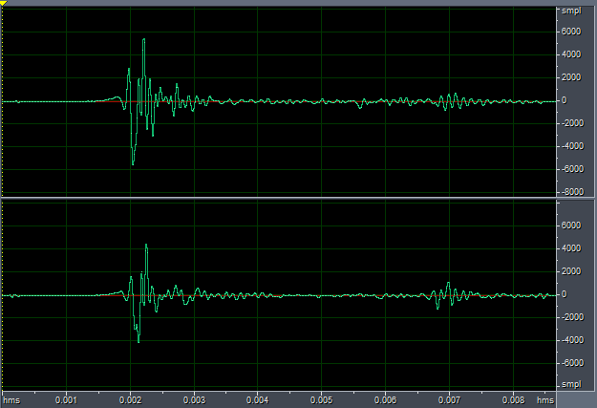
Generate new HRTFs for other instruments by modifying ILD and ITD
Direct Sound 7.5 degrees left Direct Sound 15 degrees left
After we manually balance the raw data a Matlab script creates the other HRTFs automatically.

Slide 29
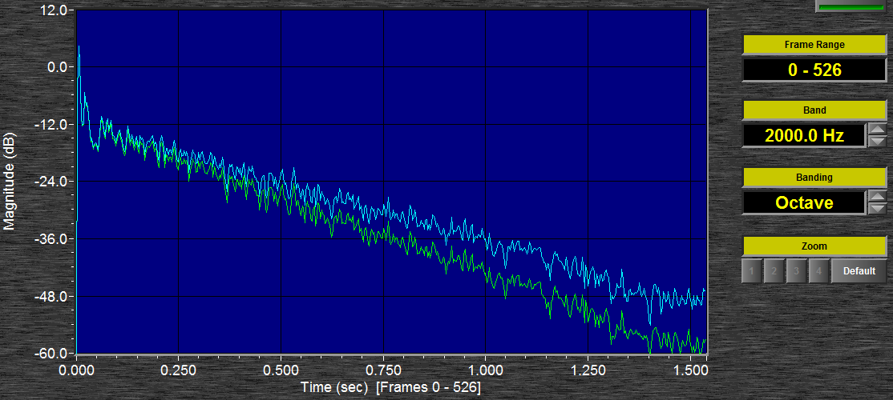
We can also convert un-occupied data to occupied.
Un-occupied BSH data has a 2000Hz RT of 2.3 seconds
A Matlab script easily modifies this to 1.9 seconds

Slide 30
Another Matlab script can then creates three separate binaural tracks with generic equalization:
1. A binaural track for the direct sound only.
2. A binaural track for the first reflection only.
3. A binaural track for the reverberation without the first reflection.
The tracks can then be heard in any combination on individually equalized headphones, with the ability to modify the loudness and equalization of each track.

Slide 31
We can then A/B compare different combinations on individually equalized headphones
Direct Only
1st Refl Only
Direct+1st
Reverb Only
All Together
All no 1st
Deleting the first reflection in seat DD 11 makes an enormous improvement in both proximity and envelopment!

Slide 32
How can we equalize headphones individually?
We have developed a computer app that enables an interested listener to match a particular headphone to their own ears through an equal loudness test.
We find that not all headphone types work well for binaural reproduction, although all types are improved by this technique.
On-ear phones with a diaphragm as close as possible to the ear canal, or high-quality insert phones appear to work best.
I encourage anyone with an interest in acoustic research to try this app during this conference.

Slide 33
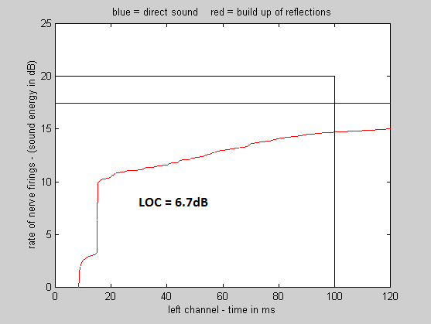
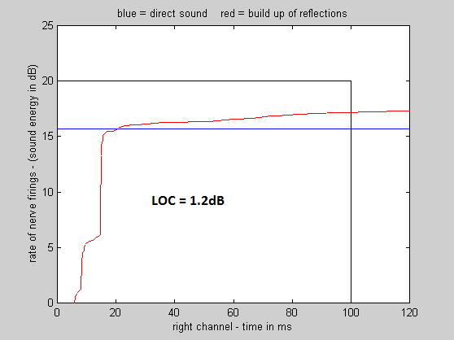
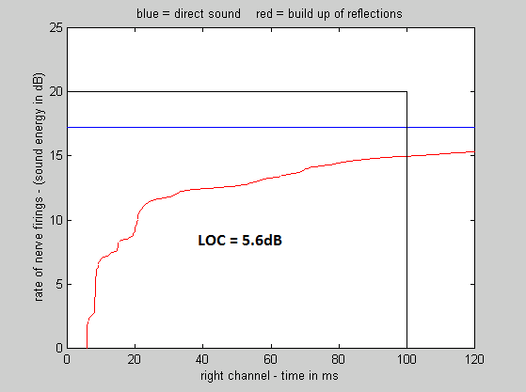
Is the difference in sound from deleting the first reflection measurable with LOC?
LOC measurements in seat DD 11
LOC in the left ear in seat DD 11 LOC in the right ear in seat DD 11 LOC in the right ear with no 1st reflection
We learned that the perception of “Proximity” is best predicted by the measured LOC value in the lesser of the two ears. A LOC value of 1.2 dB is unacceptable, and a value of 5.6 is good.

Slide 34
Measurements at the Weiss Center, Bucknell
We used Lokki’s string quartet with a soprano at the Weiss Center at Bucknell University in the summer of 2013.
We recorded the electronic performances with the soundfield and two dummy heads.
We also recorded impulse responses to the microphones from the soprano speaker and two dodecahedral speakers on the left and right of the center.
The stage was then modified by adding a set of heavy curtains, and the recordings were repeated.

Slide 35
The difference in sound was not subtle, either in person or in the recordings
The stage floor was bare in both conditions, and the hall was empty.
The soundfield recordings show clearly that when there were no curtains there were a great many multiple reflections coming from the stage house.
The sound further back than row T was muddy, as was the sound in the rear balcony.
Adding the curtains made the sound clear all the way to the back of the hall
The sound was not subjectively less loud – and the hall was more audible rather than less.

Slide 36
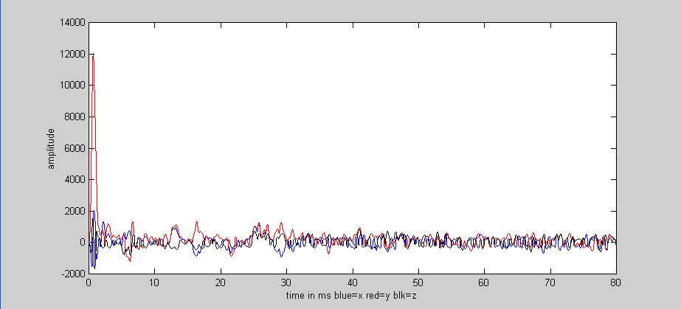
The soundfield impulse responses showed excess early reflections from the stage house, not the side wall.
Soundfield traces in seat V 105 with no curtains.
Soundfield traces in V 105 after curtains were installed.

Slide 37
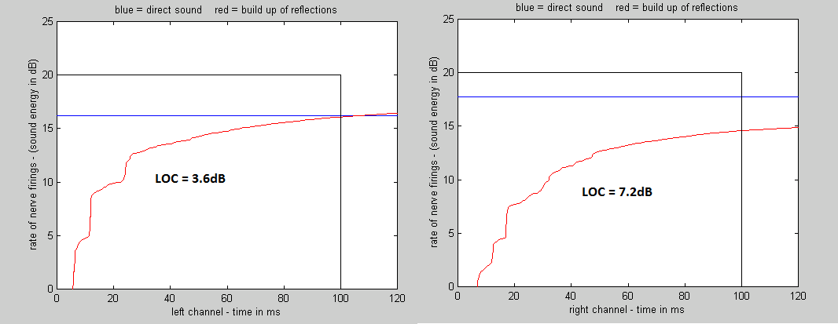
LOC values in the Weiss Center with a directive speaker
LOC values in seat V 105 with no curtains from the most directive speaker – (the soprano)
LOC values in seat 105 from the soprano speaker with curtains installed. We learn that LOC = 3.6dB is better than LOC = 2.7.

Slide 38
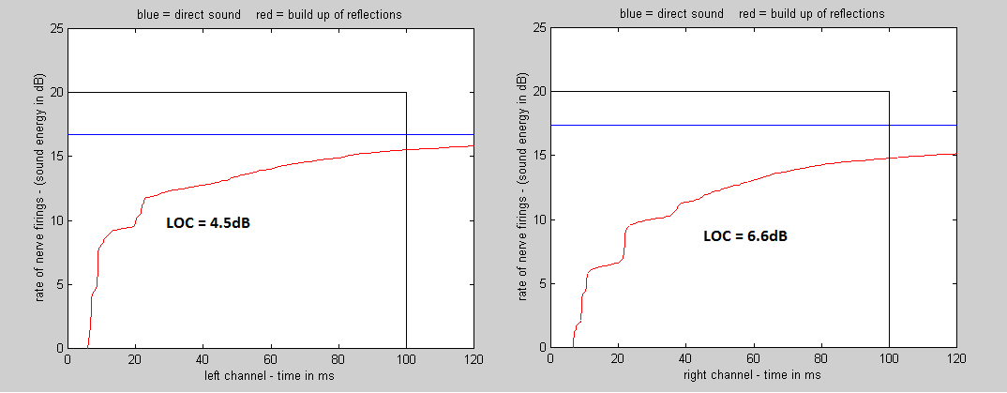
LOC values in the Weiss Center with an omni speaker
LOC values with no curtains.
LOC values with curtains.

Slide 39
The improvement in LOC is not spectacular
Adding the stage curtains reduced the reverberation time from under 2 seconds to under 1.8 seconds.
This reduces the masking of succeeding notes from the reverberation of previous notes.

Slide 40
Stage curtains in Bucknell reduce the reverberant level with a minimum effect on the reverberation time.
This is done by adding absorption just around the bottom of the stage house, and adding a proscenium curtain.
Basically, you want to create an absorptive shell, catching excess direct sound before it reverberates.
The reverberant level goes down, flutter echoes on stage will be removed, and musicians will applaud the change.

Slide 41
Conclusions
Binaural technique can be a practical standard against which other hall research techniques can be judged.
But ideally this requires individual headphone equalization.
Headphones can be non-invasively equalized to match individuals through loudness matching.
Existing binaural data can be balanced and equalized to yield a very good snapshot of the sound in a particular seat.
This data can be further manipulated to discover why the sound is good, or how to improve it if it is not.
Using these techniques we find the first-order lateral reflections in Boston Symphony Hall are excessive.
In every seat tested they are either inaudible, or they reduce or eliminate proximity.

Slide 42
Boston Symphony Hall is marvelous, but it could be even better
Chris Blair’s Schermerhorn hall in Nashville.
You are welcome to hear my recordings of this concert, either from this seat or another further back.

